Slide 1
SQL FUNDAMENTALS
CDSE Days 2018

Slide 2
What is SQL?
Structured Querying Language – computer language for relational database management and data manipulation
Sequel
Cannot write complete applications → All about the data
Read
Write
Update

Slide 3
SQL Syntax
Unlike other languages there are multiple variations
DataBase Management Systems (DBMS)
SQL Server
MySQL
Microsoft SQL Server
Oracle (IBM DB2)
…

Slide 4
Database
A container of organized data that is related
Tables: a structured list of data
Columns: single fields in a table
Rows: a record in a table

Slide 5
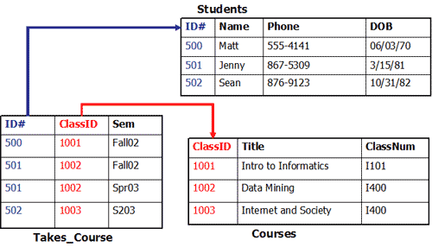
Data Models
Each table represents an entity and is related to other through a common field (key).
From: https://github.com/talhafazal

Slide 6
Model Components
Entity: Person, place thing or event. Distinguishable, unique and distinct
Attribute: characteristic of an entity
Relationship: association between entities
One to many
Many to many
One to one
Key: Identifier for each row. Unique and can be used in other tables to create relationships (foreign key)
All comes together in an ERD (Entity Relationship Diagram) that uses standard notation.

Slide 7
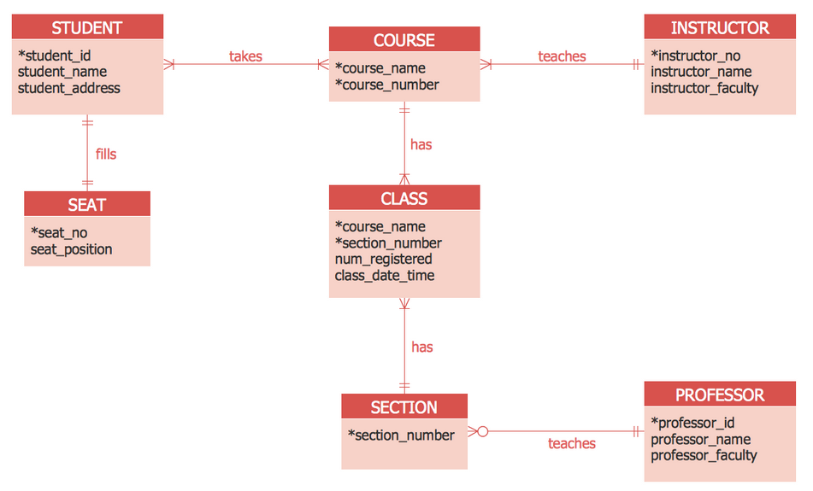
ERD Example

Slide 8
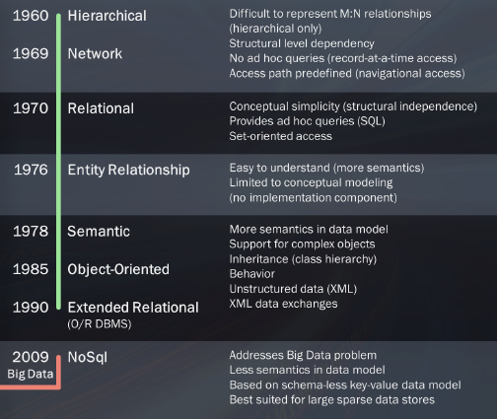
Evolution of Data Models
Data models have evolved with “data growth”
From: University of California, Davis Extension – Sadie St. Lawrence

Slide 9
Types of models
Relational models focus on relationships and how data can be easily manipulated.
Transactional models are historical and are becoming more popular with big data technology… Data warehouses are more prevalent and DBMS suppliers are adapted to the needs of big data

Slide 10
Where to Start?
Problem Identification
Data Structure
Business Rules
The Data Model is a great starting point

Slide 11
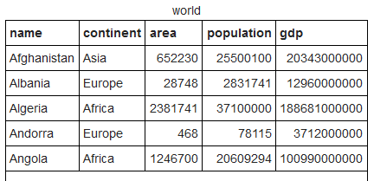
SELECT STATEMENT
The SELECT statement has 2 components:
What you want
Where to get it
SELECT population
FROM world;

Slide 12
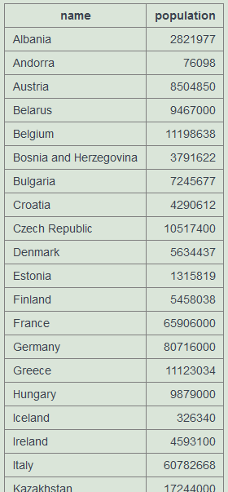
SELECT STATEMENT
Results can be expanded or restricted:
SELECT name, population
FROM world
WHERE continent = ‘Europe’;

Slide 13
Creating your own tables
The CREATE TABLE statement is used to create new tables in a database.
CREATE TABLE games
(
yr INT NOT NULL PRIMARY KEY,
city VARCHAR(20) NOT NULL,
);

Slide 14
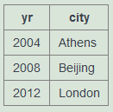
Creating your own tables
The INSERT INTO statement is used to populate those tables
INSERT INTO games(yr,city) VALUES (2004,'Athens');
INSERT INTO games(yr,city) VALUES (2008,'Beijing');
INSERT INTO games(yr,city) VALUES (2012,'London');
SELECT * FROM games;

Slide 15
Comments
Adding comments to code is a fundamental element of good programming practices.
/* SQL Comments are enclosed in */
/* This table is being created as an example */
CREATE TABLE games(
yr INT NOT NULL PRIMARY KEY,
city VARCHAR(20) NOT NULL,
);

Slide 16
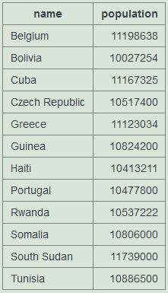
WHERE Clause
The WHERE clause allows us to be specific in our queries, reducing the number of records retrieved.
This clause allows the use of OPERATORS to further restrict the results
SELECT name, population
FROM world
WHERE population BETWEEN 10000000
AND 12000000;

Slide 17
Operator | Description
= | Equal
< > | Not Equal (Some SQL variations use !=)
> | Greater Than
< | Less Than
> = | Greater Than or Equal
< = | Less Than or Equal
BETWEEN | Between an inclusive range
IS NULL | Is a null value
IN | Specifies a range of conditions
OR | Avoids evaluating a 2nd condition if the 1st is met
AND | Can be used with other operators
NOT | Excludes results

Slide 18
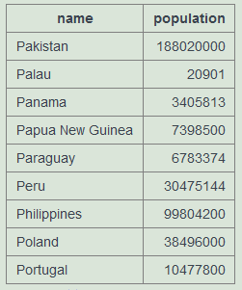
Wildcards
SQL uses * as a wildcard:
SELECT *
FROM world;
Other wildcards are used with a LIKE operator and include:
% (perc%)
_ (under _)
SELECT name, population
FROM world
WHERE name LIKE 'P%';

Slide 19
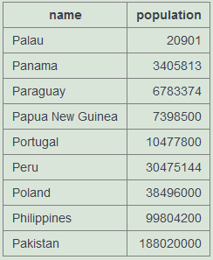
ORDER BY
Using the ORDER BY clause allows us to sort data, and can be used with columns that are not retrieved.
This clause is always the last one in a SELECT statement.
SELECT name, population
FROM world
WHERE name LIKE 'P%'
ORDER BY population ASC;

Slide 20
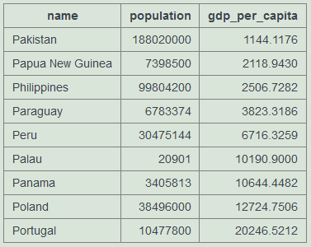
Mathematical operators
Mathematical operators allow you to compute fields that are not included in your saved data.
SELECT name, population, gdp/population AS gdp_per_capita
FROM world
WHERE name LIKE 'P%'
ORDER BY 3 ASC;

Slide 21
Aggregate Functions
Aggregate functions are used to summarize data, and use descriptive statistics measures.
Function | Description
AVG ( ) | Averages a column of values
COUNT ( ) | Counts the number of values
MIN ( ) | Finds the minimum value in a range
MAX ( ) | Find the maximum value in a range
SUM ( ) | Sums the column values
DISTNCT | Can be used with some aggregate functions
SELECT COUNT (DISTINCT city)
FROM games;

Slide 22
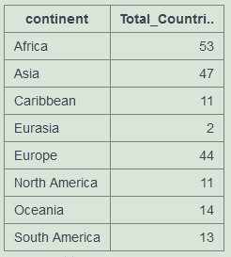
Grouping Data
SQL allows us to group data and summarize subsets of data:
GROUP BY clause
SELECT continent, COUNT(name) as Total_Countries
FROM world
GROUP BY continent;

Slide 23
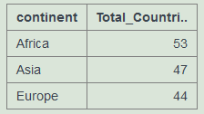
Grouping Data
To filter data that is already grouped the HAVING clause must be used (instead of the WHERE clause)
SELECT continent, COUNT(name) as Total_Countries
FROM world
GROUP BY continent
HAVING COUNT (name) >15;

Slide 24
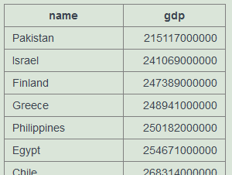
Nesting Queries
Queries can be combined, to generate more restricted sets of results.
SELECT name, gdp FROM world
WHERE gdp >
(SELECT gdp FROM world
WHERE name='Portugal')
ORDER BY gdp ASC;

Slide 25
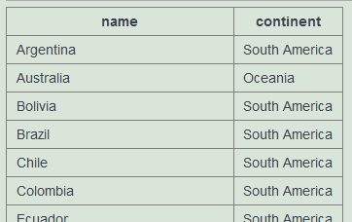
Example
List the name of countries in the continents containing either Argentina or Australia. Order by the name of the country.
SELECT name, continent FROM world
WHERE continent IN
(SELECT continent FROM world
WHERE name IN ('Argentina', 'Australia'))
ORDER BY name ASC;

Slide 26
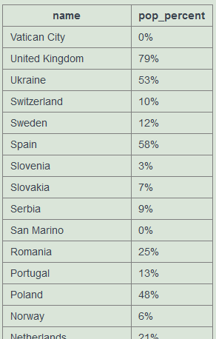
Example
Germany (population 80 million) has the largest population of the countries in Europe. Portugal (population 10.5 million) has 13% of the population of Germany. Show the name and the population of
each country in Europe. Show the population as
A percentage of the population of Germany
SELECT name,
CONCAT(ROUND(100*population/(SELECT population FROM world
WHERE name = 'Germany')), '%') AS pop_percent
FROM world
WHERE continent = 'Europe'
ORDER BY name DESC;

Slide 27
Nesting queries Best Practices
No limit to the number of subqueries that you can have
Performance is affected with deeply nested statements
Coding format is important
Notepad ++
www.poorsql.com
commenting

Slide 28
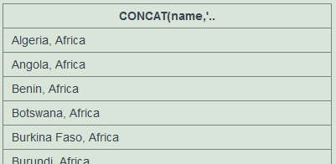
String Functions
Concatenation
SELECT CONCAT(name,', ', continent)
FROM world;

Slide 29
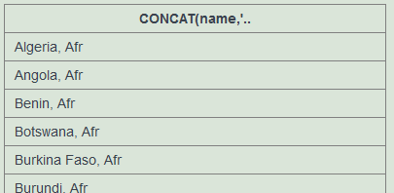
String Functions
Trimming spaces
SELECT CONCAT(name,', ', SUBSTR(continent,1,3))
FROM world;

Slide 30
Resources
https://sqlzoo.net
https://www.w3schools.com/

